Slide 1
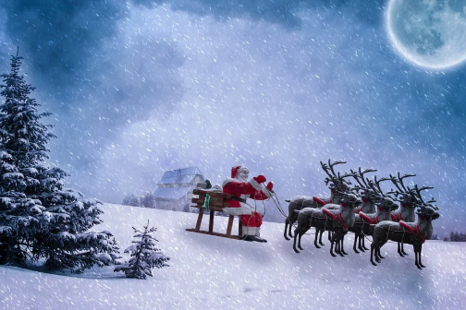
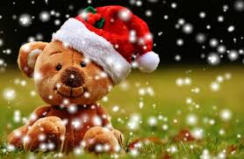
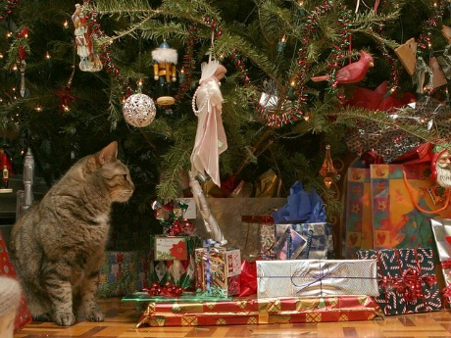
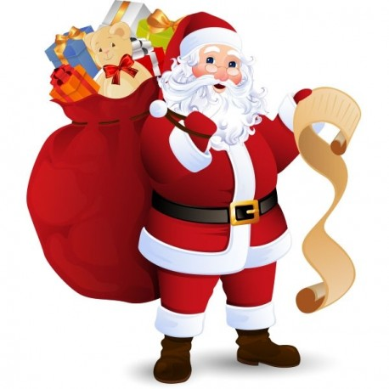
What can you see on the following pictures ?
Try to name the most things you can !
Tell the poem, sing the songs : enjoy !

Slide 2
snow
Santa Claus hat
A teddy bear
Christmas poem : Christmas is bright

Slide 3
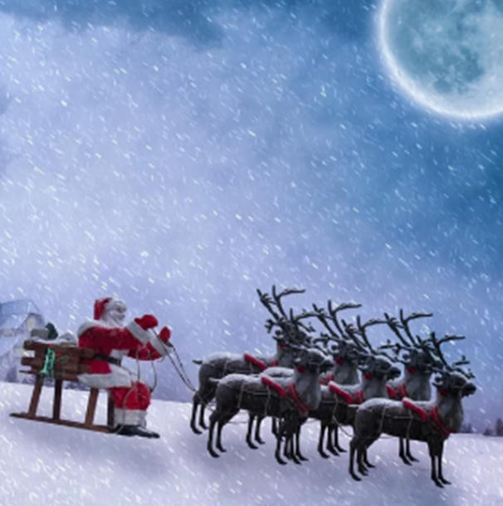
The moon
Snow
The reindeer
Santa Claus
Father Christmas
A sleigh
Listen and sing Jingle bells

Slide 4
Presents
Listen to my song !
A teddy bear
Father Christmas’s sack
A list
Boots

Slide 5
We wish you a merry Christmas !
The Christmas tree
A bauble
A tinsel
A cat
Presents

Slide 6
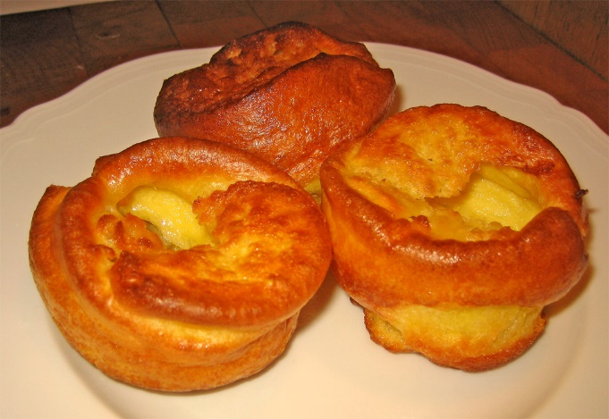
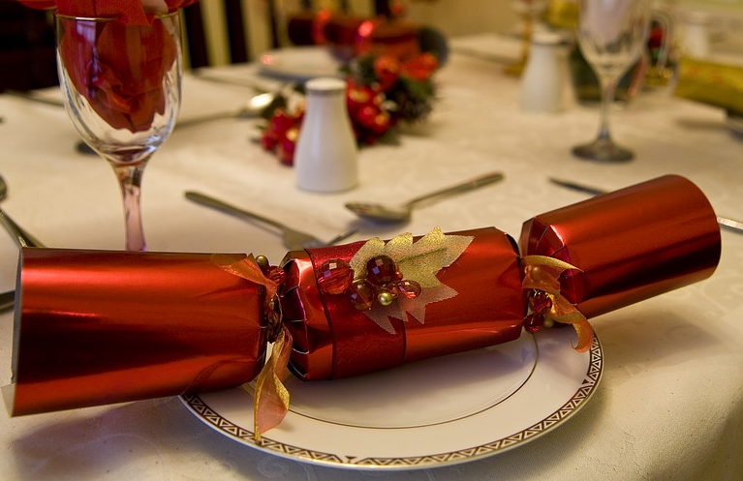
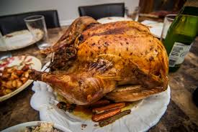
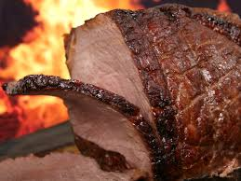
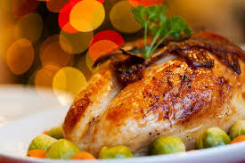
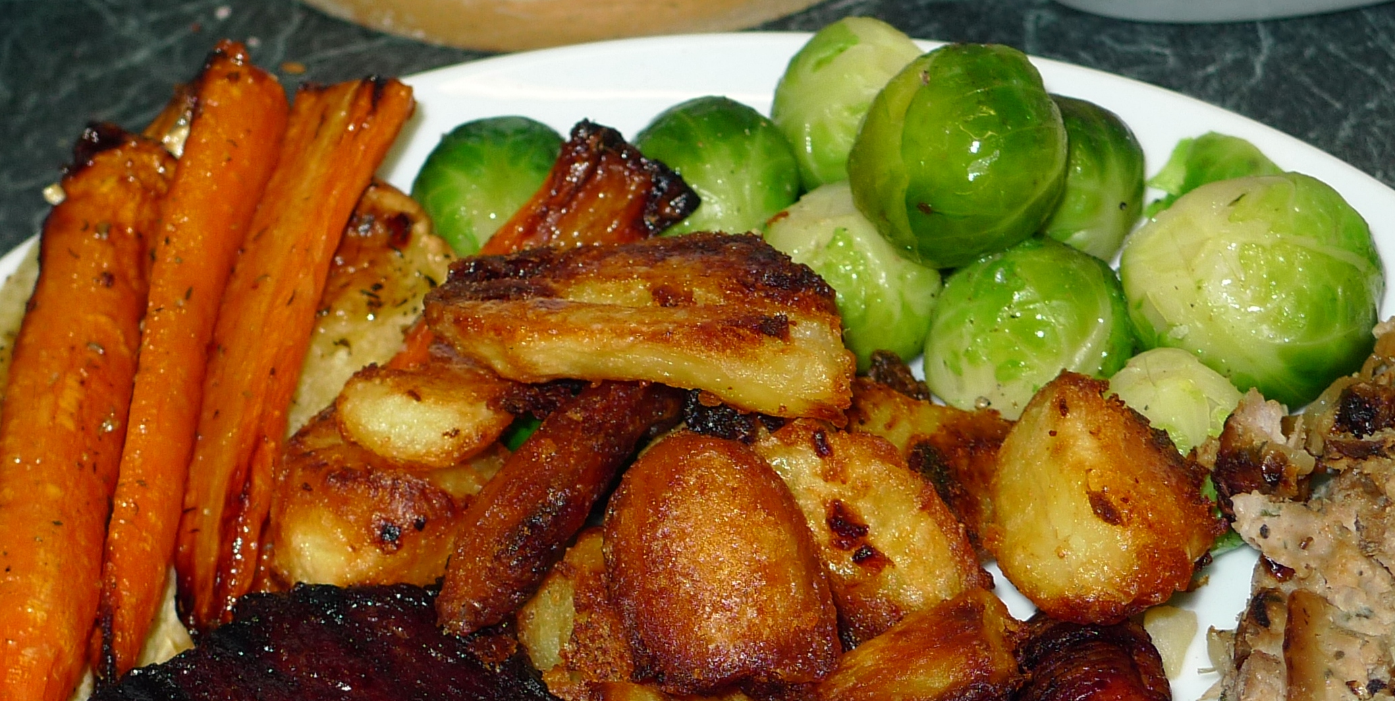
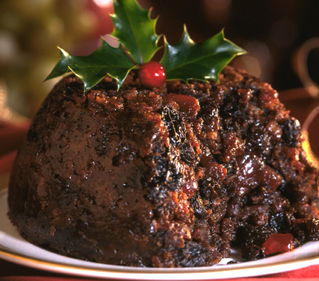
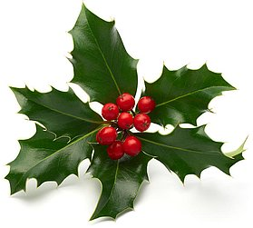
What’s up for dinner ?
Yorkshire puddings
Crackers
Roast goose
Roast beef
Vegetables
(with brussels sprouts)
Turkey
Poem : Pull the cracker
Christmas pudding
(With a sprig of holly)

